Slide 1
S2-19_DSECLZC415 Outliers/Anomalies Detection & Analysis Problems in Proximity Based Outliers SESSION 12
AUGUST 1 2020 – Dr.D.VENKATA SUBRAMANIAN
Slide Courtesy: Prof. T.V. Rao

Slide 2
K-NN ALGORITHM
Dr.D.VENKAT

Slide 3
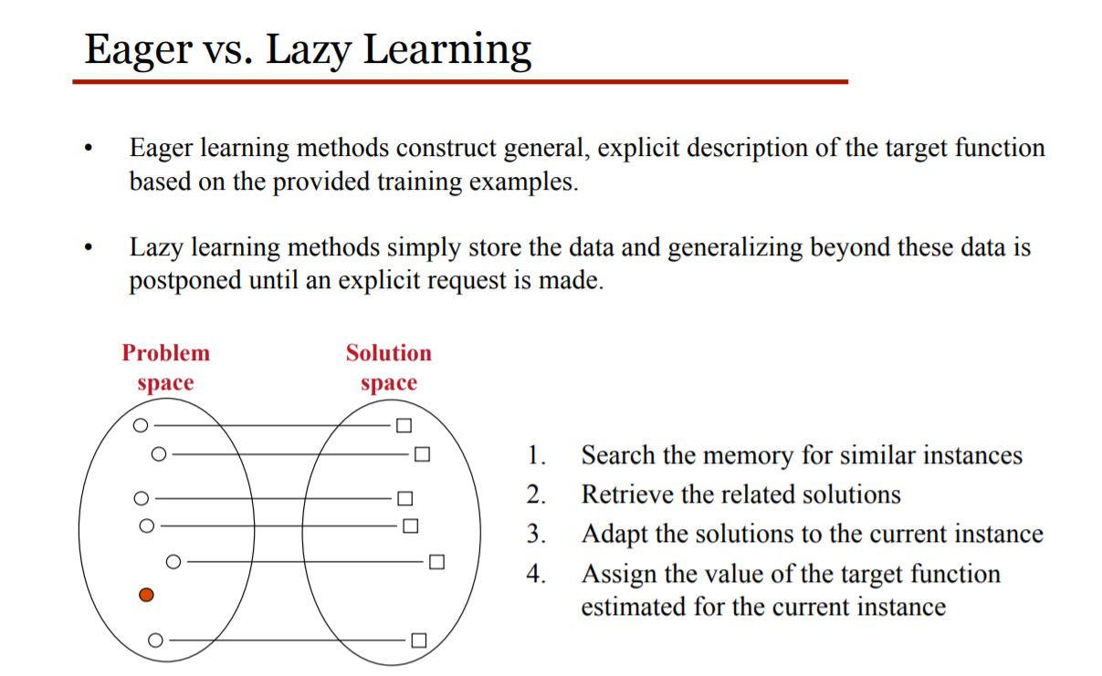
Lazy vs Eager Learners
LAZY LEARNING ALGORITHM: Simply Stores the training data without doing any further munging on it , till it gets the next test set. It's slow as it calculates based on the current data set instead of coming up with an algorithm based on historic data. Localized data so generalization takes time at every iteration
Examples of Lazy Learning Methods
K-nearest neighbors(K-NN), which is a special case of instance-based learning.
Local regression, Lazy naive Bayes rules, case based reasoning.
EAGER LEARNING ALGORITHM:-Munges the training data as soon as it receives it. Given a set of training set, constructs a classification model before receiving new (e.g., test) data to classify. Examples - Decision Tree, Naive Bayes, Artificial Neural Networks

Slide 4
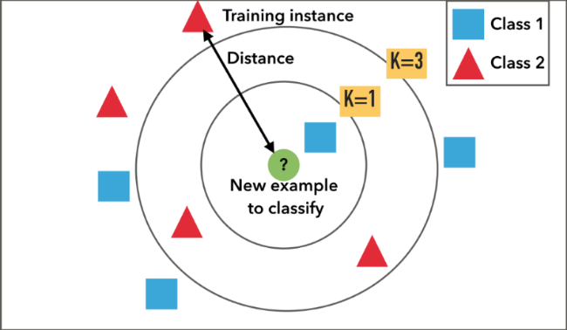
K-NN
K-nearest neighbors (KNN) algorithm is a type of supervised ML algorithm which can be used for both classification as well as regression predictive problems. However, it is mainly used for classification predictive problems in industry. The following two properties would define KNN well −
Lazy learning algorithm − KNN is a lazy learning algorithm because it does not have a specialized training phase and uses all the data for training while classification.
Non-parametric learning algorithm − KNN is also a non-parametric learning algorithm because it doesn’t assume anything about the underlying data.
The algorithm can be summarized as:
A positive integer k is specified, along with a new sample
We select the k entries in our database which are closest to the new sample
We find the most common classification of these entries
This is the classification we give to the new sample

Slide 5
Working of KNN Algorithm
K-nearest neighbors (KNN) algorithm uses ‘feature similarity’ to predict the values of new datapoints which further means that the new data point will be assigned a value based on how closely it matches the points in the training set. We can understand its working with the help of following steps −
Step 1 − For implementing any algorithm, we need dataset. So during the first step of KNN, we must load the training as well as test data.
Step 2 − Next, we need to choose the value of K i.e. the nearest data points. K can be any integer.
Step 3 − For each point in the test data do the following −
3.1 − Calculate the distance between test data and each row of training data with the help of any of the method namely: Euclidean, Manhattan or Hamming distance. The most commonly used method to calculate distance is Euclidean.
3.2 − Now, based on the distance value, sort them in ascending order.
3.3 − Next, it will choose the top K rows from the sorted array.
3.4 − Now, it will assign a class to the test point based on most frequent class of these rows. (voting..)
Step 4 − End
ONE SOLVED PROBLEM… DEMO

Slide 6
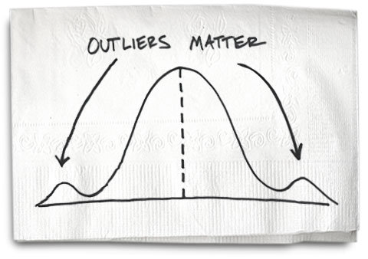
What Are Outliers/Anomalies?
Outlier: A data object that deviates significantly from the normal objects as if it were generated by a different mechanism
Outliers are different from the noise data
Noise is random error or variance in a measured variable
Noise should be removed before outlier detection
Outliers are interesting: It violates the mechanism that generates the normal data
Applications:
Credit card fraud detection
Telecom fraud detection
Customer segmentation
Medical analysis
Outliers are extreme values that deviate from other observations on data , they may indicate a variability in a measurement, experimental errors or a novelty. In other words, an outlier is an observation that diverges from an overall pattern on a sample.
Univariate outliers can be found when looking at a distribution of values in a single feature space.
Multivariate outliers can be found in a n-dimensional space (of n-features).

Slide 7
Common Causes/Reasons/Sources for Outliers
Data entry errors (human errors)
Measurement errors (instrument errors)
Experimental errors (data extraction or experiment planning/executing errors)
Intentional (dummy outliers made to test detection methods)
Data processing errors (data manipulation or data set unintended mutations)
Sampling errors (extracting or mixing data from wrong or various sources)
Natural (not an error, novelties in data)

Slide 8
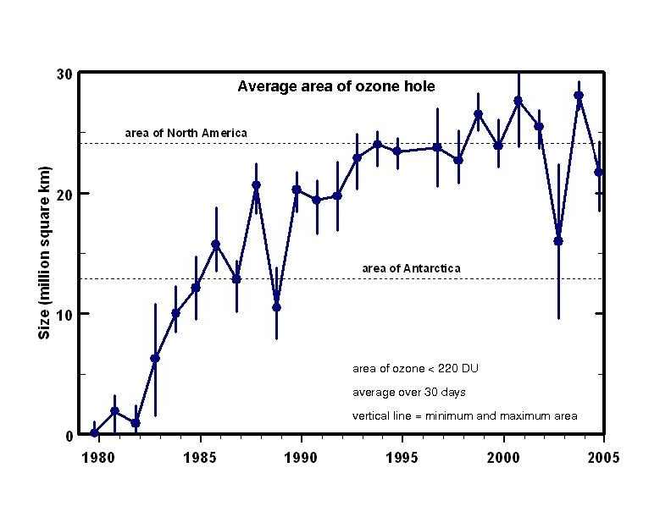
Importance of Anomaly Detection
Ozone Depletion History
In 1977 three researchers (Farman, Gardinar and Shanklin) were puzzled by data gathered by the British Antarctic Survey showing that ozone levels for Antarctica had dropped 10% below normal levels
Why did the Nimbus 7 satellite, which had instruments aboard for recording ozone levels, not record similarly low ozone concentrations? The researchers held back publishing their work for nearly a decade.
The ozone concentrations recorded by the satellite were so low they were being treated as outliers by a computer program and discarded!
Sources: “Cosmic Imagery: Key Images in the History of Science” By John D. Barrow http://www3.epa.gov/ozone/science
https://commons.wikimedia.org/wiki/File:Ozone_hole_area.jpg

Slide 9
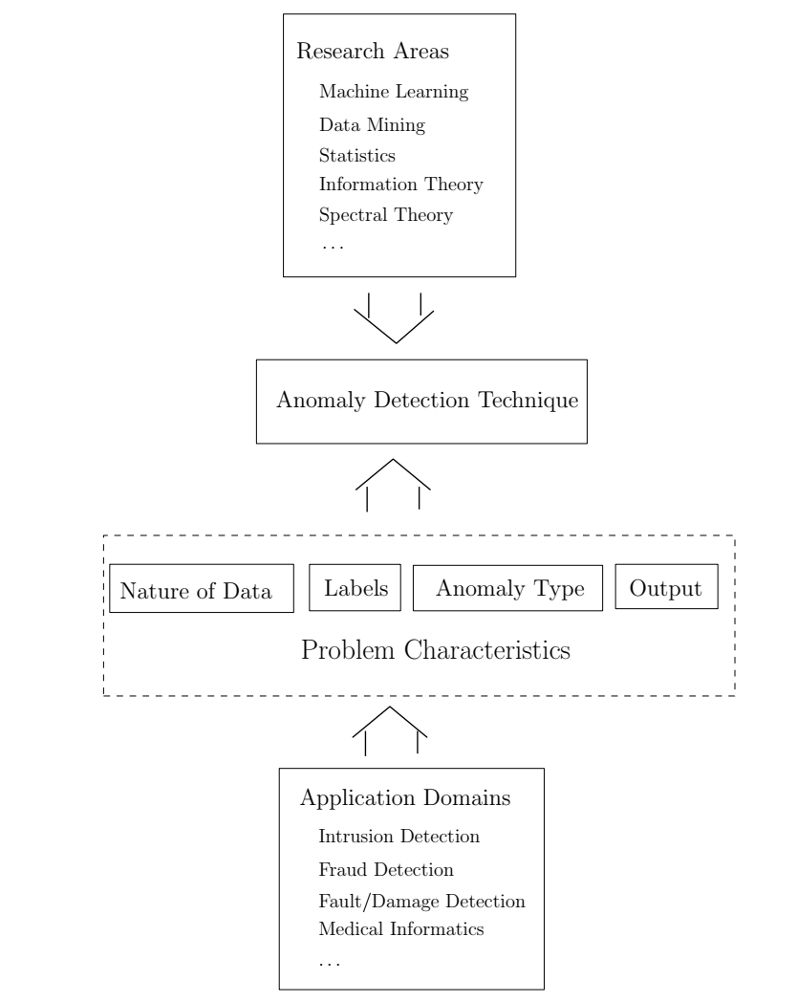
Key components associated with an anomaly detection technique
Anomaly Detection : A Survey by Varun Chandola, Arindam Banerjee And Vipin Kumar University of Minnesota ACM Computing Surveys, September 2009

Slide 10
More on Outlier/Anomaly Detection
Challenges
How many outliers are there in the data?
Method is unsupervised
Validation can be quite challenging (just like for clustering)
Finding needle in a haystack
Working assumption:
There are considerably more “normal” observations than “abnormal” observations (outliers/anomalies) in the data
Outlier detection vs. novelty detection (identify new topics and trends in a timely manner in social media): early stage, outlier; but later merged into the model

Slide 11
Types of Outliers
Three kinds: global, contextual and collective outliers
Global outlier (or point anomaly)
Object is O_{g} if it significantly deviates from the rest of the data set
Ex. Intrusion detection in computer networks
Issue: Find an appropriate measurement of deviation
Contextual outlier (or conditional outlier)
Object is O_{c} if it deviates significantly based on a selected context
Ex. 80º F in Urbana: outlier? (depending on summer or winter?)
Attributes of data objects should be divided into two groups
Contextual attributes: defines the context, e.g., time & location
Behavioral attributes: characteristics of the object, used in outlier evaluation, e.g., temperature
Can be viewed as a generalization of local outliers—whose density significantly deviates from its local area
Issue: How to define or formulate meaningful context?
Point outliers are single data points that lay far from the rest of the distribution.
Contextual outliers can be noise in data, such as punctuation symbols when realizing text analysis or background noise signal when doing speech recognition.
Collective outliers can be subsets of novelties in data such as a signal that may indicate the discovery of new phenomena
11

Slide 12
Types of Outliers (Contd.)
Collective Outliers
A subset of data objects collectively deviate significantly from the whole data set, even if the individual data objects may not be outliers
Applications: E.g., intrusion detection:
When a number of computers keep sending denial-of-service packages to each other
Detection of collective outliers
Consider not only behavior of individual objects, but also that of groups of objects
Need to have the background knowledge on the relationship among data objects, such as a distance or similarity measure on objects.
A data set may have multiple types of outlier
One object may belong to more than one type of outlier
12

Slide 13
Most popular methods for outlier detection
Z-Score or Extreme Value Analysis (parametric)
Probabilistic and Statistical Modeling (parametric)
Linear Regression Models (PRINCIPAL COMPONENT ANALYSIS(PCA), LEAST MEDIAN OF SQUARES(LMS))
Proximity Based Models (non-parametric)
Information Theory Models
High Dimensional Outlier Detection Methods (high dimensional sparse data)

Slide 14
Outlier Detection I: Supervised Methods
Two ways to categorize outlier detection methods:
Based on whether user-labeled examples of outliers can be obtained:
Supervised, semi-supervised vs. unsupervised methods
Based on assumptions about normal data and outliers:
Statistical, proximity-based, and clustering-based methods
Outlier Detection I: Supervised Methods
Modeling outlier detection as a classification problem
Samples examined by domain experts used for training & testing
Methods for Learning a classifier for outlier detection effectively:
Model normal objects & report those not matching the model as outliers, or
Model outliers and treat those not matching the model as normal
Challenges
Imbalanced classes, i.e., outliers are rare: Boost the outlier class and make up some artificial outliers
Catch as many outliers as possible, i.e., recall is more important than accuracy (i.e., not mislabeling normal objects as outliers)
14

Slide 15
Outlier Detection II: Unsupervised Methods
Assume the normal objects are somewhat ``clustered'‘ into multiple groups, each having some distinct features
An outlier is expected to be far away from any groups of normal objects
Weakness: Cannot detect collective outlier effectively
Normal objects may not share any strong patterns, but the collective outliers may share high similarity in a small area
Ex. In some intrusion or virus detection, normal activities are diverse
Unsupervised methods may have a high false positive rate but still miss many real outliers.
Supervised methods can be more effective, e.g., identify attacking some key resources
Many clustering methods can be adapted for unsupervised methods
Find clusters, then outliers: not belonging to any cluster
Problem 1: Hard to distinguish noise from outliers
Problem 2: Costly since first clustering: but far less outliers than normal objects
Newer methods: tackle outliers directly
15

Slide 16
Outlier Detection III: Semi-Supervised Methods
Situation: In many applications, the number of labeled data is often small: Labels could be on outliers only, normal objects only, or both
Semi-supervised outlier detection: Regarded as applications of semi-supervised learning
If some labeled normal objects are available
Use the labeled examples and the proximate unlabeled objects to train a model for normal objects
Those not fitting the model of normal objects are detected as outliers
If only some labeled outliers are available, a small number of labeled outliers many not cover the possible outliers well
To improve the quality of outlier detection, one can get help from models for normal objects learned from unsupervised methods
16

Slide 17
Mining Contextual Outliers: Transform into Conventional Outlier Detection
If the contexts can be clearly identified, transform it to conventional outlier detection
Identify the context of the object using the contextual attributes
Calculate the outlier score for the object in the context using a conventional outlier detection method
Ex. Detect outlier customers in the context of customer groups
Contextual attributes: age group, postal code
Behavioral attributes: # of trans/yr, annual total trans. amount
Steps:
(1) locate c’s context,
(2) compare c with the other customers in the same group, and
(3) use a conventional outlier detection method
17

Slide 18
Mining Contextual Outliers: Modeling Normal Behavior with Respect to Contexts
In some applications, one cannot clearly partition the data into contexts
Ex. if a customer suddenly purchased a product that is unrelated to those she recently browsed, it is unclear how many products browsed earlier should be considered as the context
Model the “normal” behavior with respect to contexts
Using a training data set, train a model that predicts the expected behavior attribute values with respect to the contextual attribute values
An object is a contextual outlier if its behavior attribute values significantly deviate from the values predicted by the model
Using a prediction model that links the contexts and behavior, these methods avoid the explicit identification of specific contexts
Methods: A number of classification and prediction techniques can be used to build such models, such as regression, Markov Models, and Finite State Automaton
18

Slide 19
Mining Collective Outliers : On the Set of “Structured Objects”
Collective outlier - objects as a group deviate from the entire data
Need to examine the structure of the data set,
i.e, the relationships between multiple data objects
Each of these structures is inherent to its respective type of data
For temporal data (such as time series and sequences)
explore the structures formed by time, which occur in segments of the time series or subsequences
For spatial data, explore local areas
For graph and network data, we explore subgraphs
Difference from the contextual outlier detection: the structures are often not explicitly defined, and have to be discovered as part of the outlier detection process.
Collective outlier detection methods: two categories
Reduce the problem to conventional outlier detection
Identify structure units, treat each structure unit (e.g., subsequence, time series segment, local area, or subgraph) as a data object, and extract features
Then outlier detection on the set of “structured objects” constructed as such using the extracted features
19

Slide 20
Mining Collective Outliers II: Direct Modeling of the Expected Behavior of Structure Units
Models the expected behavior of structure units directly
Ex. 1. Detect collective outliers in online social network of customers
Treat each possible subgraph of the network as a structure unit
Collective outlier: An outlier subgraph in the social network
Small subgraphs that are of very low frequency
Large subgraphs that are surprisingly frequent
Ex. 2. Detect collective outliers in temporal sequences
Learn a Markov model from the sequences
A subsequence can then be declared as a collective outlier if it significantly deviates from the model
Collective outlier detection is subtle due to the challenge of exploring the structures in data
The exploration typically uses heuristics, and thus may be application dependent
The computational cost is often high due to the sophisticated mining process
20

Slide 21
Challenges of Outlier Detection
Modeling normal objects and outliers properly
Hard to enumerate all possible normal behaviors in an application
The border between normal and outlier objects is often a gray area
Application-specific outlier detection
Choice of distance measure among objects and the model of relationship among objects are often application-dependent
E.g., clinic data: a small deviation could be an outlier; while in marketing analysis, larger fluctuations
Handling noise in outlier detection
Noise may distort the normal objects and blur the distinction between normal objects and outliers. It may help hide outliers and reduce the effectiveness of outlier detection
Understandability
Understand why these are outliers: Justification of the detection
Specify the degree of an outlier: the unlikelihood of the object being generated by a normal mechanism
21

Slide 22
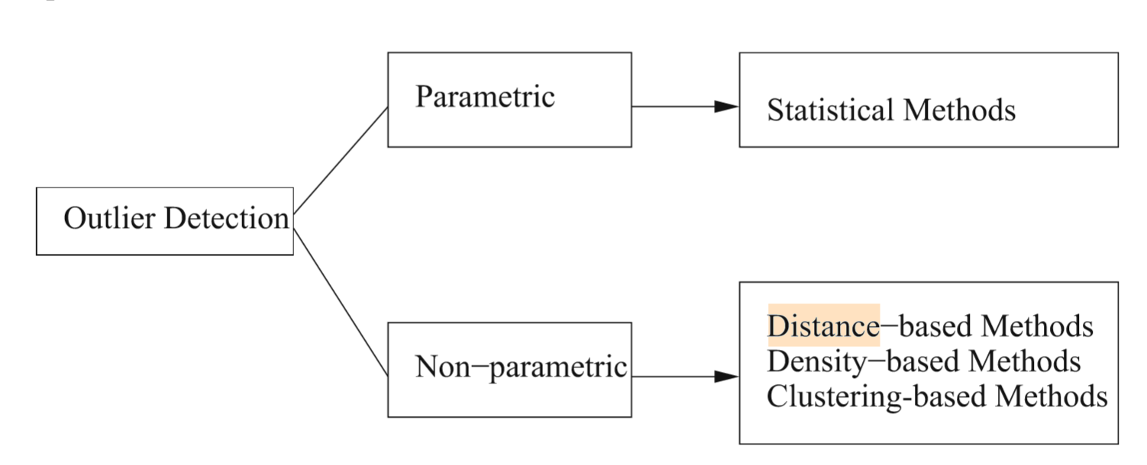
Statistical Approaches
Statistical approaches assume that the objects in a data set are generated by a stochastic process (a generative model)
The effectiveness of statistical methods highly depends on whether the assumptions made for the statistical model hold true for the given data
Statistic models used in the methods may be parametric or nonparametric.
A parametric method assumes that the normal data objects are generated by a parametric distribution (T-Test, Z-Score…..with assumptions)
A nonparametric method does not assume an a priori statistical model. Instead, a nonparametric method tries to determine the model from the input data. (Chi-square.. Without no assumptions)

Slide 23
Discordancy test
The statistical distribution-based approach identifies outliers with respect to the model using a discordancy test.
A statistical discordancy test examines first a working hypothesis. A working hypothesis, H, is a statement that the entire data set of n objects comes from an initial distribution model, F, that is,
H : o_{i} ϵ F, where i=1,2,….n
The hypothesis is retained if there is no statistically significant evidence supporting its rejection
A discordancy test verifies whether an object, o_{i}, is significantly large (or small) in relation to the distribution F
The result is very much dependent on which model F is chosen because o_{i} may be an outlier under one model and a perfectly valid value under another.

Slide 24
Alternative distributions
Inherent alternative distribution: In this case, the working hypothesis that all of the objects come from distribution F is rejected in favor of the alternative hypothesis that all of the objects arise from another distribution, G:
H_{a} : o_{i} ϵ G, where i=1,2,….n
F and G may be different distributions or differ only in parameters of the same distribution. For example, it may have a different mean or dispersion, or a longer tail.

Slide 25
Alternative distributions
Mixture alternative distribution: The mixture alternative states that discordant values are not outliers in the F population, but contaminants from some other population, G. In this case, the alternative hypothesis is
H_{a} : o_{i} ϵ (1-λ)F + λG , where i=1,2,….n
Slippage alternative distribution: This alternative states that all of the objects (apart from some prescribed small number) arise independently from the initial model, F, with its given parameters, whereas the remaining objects are independent observations from a modified version of F in which the parameters have been shifted.

Slide 26
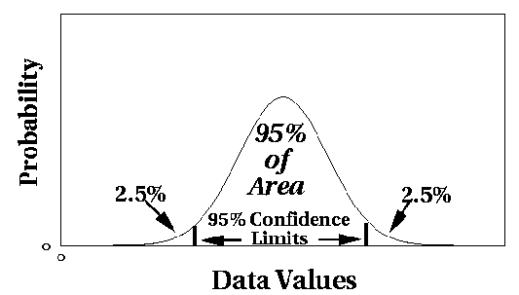
Statistical Approaches – Parametric Methods
Assumes that the normal data is generated by a parametric distribution with parameter θ
The probability density function of the parametric distribution f(x, θ) gives the probability that object x is generated by the distribution
The smaller this value, the more likely x is an outlier
The parametric distribution can be normal distribution with a mean and variance.
Outliers are points where probability of occurrence is below a threshold.

Slide 27


Parametric Methods: Univariate Outliers
Univariate data: A data set involving only one attribute or variable
Often assume that data are generated from a normal distribution, learn the parameters from the input data, and identify the points with low probability as outliers
Ex: Avg. temp.: {24.0, 28.9, 28.9, 29.0, 29.1, 29.1, 29.2, 29.2, 29.3, 29.4}
Use the maximum likelihood method to estimate μ and σ
For the above data with n = 10, we have
Then (24 – 28.61) /1.51 = – 3.04 < –3, 24 is an outlier since

Slide 28
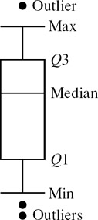
Visual Approach
A straightforward method for statistical outlier detection can also be used in visualization, e.g., the boxplot method plots the univariate input data using a five-number summary
the smallest nonoutlier value (Min),
the lower quartile (Q1),
the median (Q2),
the upper quartile (Q3), and
the largest nonoutlier value (Max).
The interquantile range (IQR) is defined as Q3 − Q1. Any object that is more than 1.5 × IQR smaller than Q1 or 1.5 × IQR larger than Q3 is treated as an outlier because the region between Q1 − 1.5 × IQR and Q3 + 1.5 × IQR contains 99.3% of the objects. The rationale is similar to using 3σ as the threshold for normal distribution

Slide 29

Parametric Methods: Detection of Multivariate Outliers
Multivariate data: A data set involving two or more attributes or variables
Transform the multivariate outlier detection task into a univariate outlier detection problem
Method 1. Compute Mahalanobis distance
Mahalanobis distance is a measure of the distance between a point P and a distribution D.
This distance is zero if P is at the mean of D, and grows as P moves away from the mean: along each principal component axis, it measures the number of standard deviations from P to the mean of D
Method 2. Use χ² –statistic:
where E_{i} is the mean of the i-dimension among all objects, and n is the dimensionality
If χ² –statistic is large, then object o_{i} is an outlier
29

Slide 30
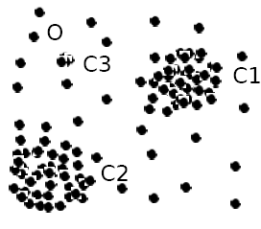
Parametric Methods: Using Mixture of Parametric Distributions
Assuming data generated by a normal distribution could be sometimes overly simplified
Example (right figure): The objects between the two clusters cannot be captured as outliers since they are close to the estimated mean
To overcome this problem, assume the normal data is generated by two normal distributions. For any object o in the data set, the probability that o is generated by the mixture of the two distributions is given by
where f_{θ1} and f_{θ2} are the probability density functions of θ₁ and θ₂
Then use EM algorithm to learn the parameters μ₁, σ₁, μ₂, σ₂ from data
An object o is an outlier if it does not belong to any cluster
(EXPECTED MAXIMATION ALGORITHM – local maxima)
30

Slide 31
Detecting outliers
There are two basic types of procedures for detecting outliers:
Block procedures: In this case, either all of the suspect objects are treated as outliers or all of them are accepted as consistent.
Consecutive (or sequential) procedures: e.g. inside-out procedure. The idea is that the object that is least "likely" to be an outlier is tested first. If it is found to be an outlier, then all of the more extreme values are also considered outliers; otherwise, the next most extreme object is tested, and so on.
(This procedure tends to be more effective than block procedures.)

Slide 32
Non-Parametric Methods: Detection Using Histogram
The model of normal data is learned from the input data without any a priori structure.
Often makes fewer assumptions about the data, and thus can be applicable in more scenarios
Outlier detection using histogram:
Figure shows the histogram of purchase amounts in transactions
A transaction in the amount of $7,500 is an outlier, since only 0.2% transactions have an amount higher than $5,000
Problem: Hard to choose an appropriate bin size for histogram
Too small bin size → normal objects in empty/rare bins, false positive
Too big bin size → outliers in some frequent bins, false negative
32

Slide 33
Proximity-Based Approaches: Distance-Based vs. Density-Based Outlier Detection
Proximity-based techniques define a data point as an outlier, if its locality (or proximity) is sparsely populated. The proximity of a data point may be defined in a variety of ways, which are subtly different from one another, but are similar enough to merit a unified treatment.
Intuition: Objects that are far away from the others are outliers
Assumption of proximity-based approach: The proximity of an outlier deviates significantly from that of most of the others in the data set
Two types of proximity-based outlier detection methods
Distance-based outlier detection: An object o is an outlier if its neighborhood does not have enough other points
Density-based outlier detection: An object o is an outlier if its density is relatively much lower than that of its neighbors
33

Slide 34
Distance-Based Outlier Detection
Distance-based outlier detection method consults the neighbourhood of an object, which is defined by a given radius.
An object is then considered an outlier if its neighborhood does not have enough other points.
A distance threshold that can be defined as a reasonable neighbourhood of the object.
For each object o we can find a reasonable number of neighbours of an object.
For each object o, examine the # of other objects in the r-neighborhood of o, where r is a user-specified distance threshold
An object o is an outlier if most (taking π as a threshold fraction or fraction threshold) of the objects in D are far away from o, i.e., not in the r-neighborhood of o
An object o is a DB(r, π) outlier if
Equivalently, one can check the distance between o and its k-th nearest neighbor o_{k}, where .
o is an outlier if dist(o, o_{k}) > r
34

Slide 35
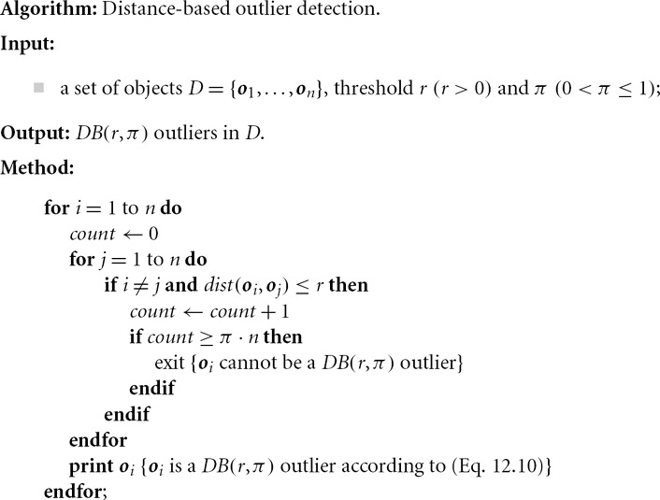
Distance-Based Outlier Detection
Efficient computation: Nested loop algorithm
For any object o_{i}, calculate its distance from other objects, and count the # of other objects in the r-neighborhood.
If π∙n other objects are within r distance, terminate the inner loop
Otherwise, o_{i} is a DB(r, π) outlier
Efficiency: Actually CPU time is not O(n²) but linear to the data set size since for most non-outlier objects, the inner loop terminates early
35

Slide 36
Distance-Based Outlier Detection: Improving Algorithm
Why efficiency is still a concern? When the complete set of objects cannot be held into main memory, cost of I/O swapping will be high
The major cost:
(1) each object tests against the whole data set, why not only its close neighbor?
(2) instead of checking objects one by one, why not group by group?
Grid-based method (CELL): Data space is partitioned into a multi-D grid. Only adjoining cells are checked for determining if object is an outlier
36

Slide 37
Distance-Based Outlier Detection: A Grid-Based Method
Grid-based method (CELL): Data space is partitioned into a multi-D grid. Each cell is a hyper cube with diagonal length r/2
Pruning using the level-1 & level 2 cell properties:
For any possible point x in cell C and any possible point y in a level-1 cell, dist(x,y) ≤ r
For any possible point x in cell C and any point y such that dist(x,y) ≥ r, y is in a level-2 cell
Thus we only need to check the objects that cannot be pruned, and even for such an object o, only need to compute the distance between o and the objects in the level-2 cells (since beyond level-2, the distance from o is more than r)
37

Slide 38
Distance-Based Outlier Detection: Limitations
Distance-based outliers, such as -outliers, are just one type of outlier
Distance-based outlier detection takes a global view of the data set
-outlier, for example, is far (as quantified by parameter r) from at least % of the objects in the data set. In other words, an outlier as such is remote from the majority of the data.
To detect distance-based outliers, we need two global parameters, r and π, which are applied to every outlier object.
Many real-world data sets demonstrate a more complex structure, where objects may be considered outliers with respect to their local neighborhoods, rather than with respect to the global data distribution.

Slide 39
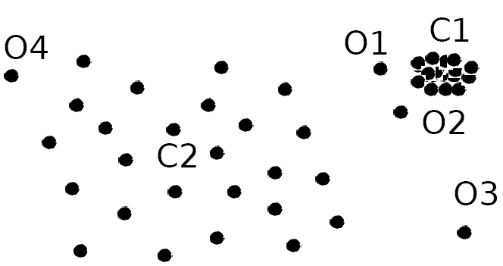
Density-Based Outlier Detection
Intuition (density-based outlier detection): The density around an outlier object is significantly different from the density around its neighbors
Method: Use the relative density of an object against its neighbors as the indicator of the degree of the object being outliers
Local outliers: Outliers comparing to their local neighborhoods, instead of the global data distribution
In Fig., o₁ and o2 are local outliers to C₁, o₃ is a global outlier, but o₄ is not an outlier. However, proximity-based clustering cannot find o₁ and o₂ are outlier (e.g., comparing with O₄).
39

Slide 40
Local Reachability Density
k-distance of an object o, dist_{k}(o): distance between o and its k-th NN
k-distance neighborhood of o, N_{k}(o) = {o’| o’ in D, dist(o, o’) ≤ dist_{k}(o)}
N_{k}(o) could be bigger than k since multiple objects may have identical distance to o
Reachability distance from o’ to o:
where k is a user-specified parameter
that controls the smoothing effect
Local reachability density of o:
40

Slide 41
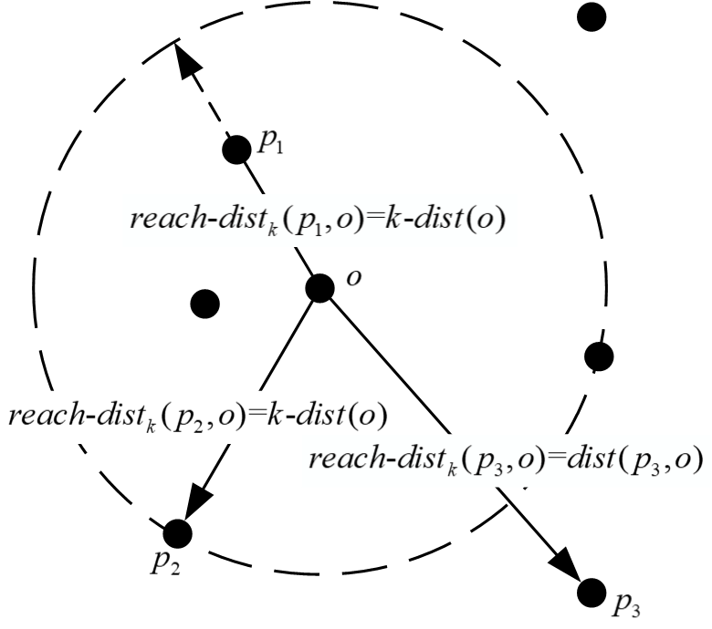
REACHABILITY DISTANCE
(reachability distance of a measurement p with respect to a measurement o). The reachability distance of a measurement p with respect to a measurement o is defined as reach-dist k (p, o) = max {k-dist(o), dist(p, o)}.
The dotted circle denotes the kdistance neighborhood of a measurement o.
Measurements p 1 and p 2 are considered to be close to the measurement o.
Thus, p 1 and p 2 are in the k-distance neighborhood of o.
Namely, reach-dist k (p 1 , o) = reach-dist k (p 2 , o) = k-dist(o).
While the measurement p 3 is considered to be far away from o, thus the reachability distance of p 3 and o is simply the actual distance between them, namely reach-dist k (p 3 , o) = dist(p 3 , o).
Therefore, the reachability distance reach-dist k (p, o) is at least the k-distance of o or the actual distance between p and o. In this way, the statistical fluctuation of dist(p, o) for all the measurements p which are the neighbors of o can be significantly reduced.

Slide 42
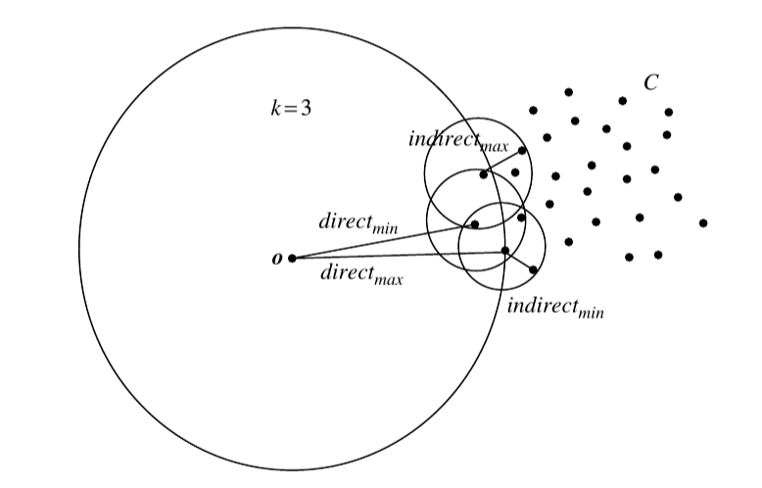

Local Outlier Factor: LOF
LOF (Local outlier factor) of an object o is the average of the ratio of local reachability of o and those of o’s k-nearest neighbors
the local outlier factor is the average of the ratio of the local reachability density of o and those of o's k-nearest neighbors
The lower the local reachability density of o, and the higher the local reachability density of the k-NN of o, the higher LOF
This captures a local outlier whose local density is relatively low comparing to the local densities of its k-NN
Local Outlier Factor (LOF) is a score that tells how likely a certain data point is an outlier/anomaly.
LOF ≈1 ⇒ no outlier
LOF ≫1 ⇒ outlier
42

Slide 43
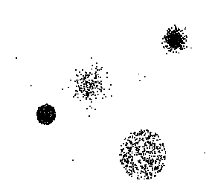
Clustering-Based
Basic idea:
Cluster the data into groups of different density
Choose points in small cluster as candidate outliers
Compute the distance between candidate points and non-candidate clusters.
If candidate points are far from all other non-candidate points, they are outliers

Slide 44


Base Rate Fallacy
Bayes theorem:
More generally:

Slide 45
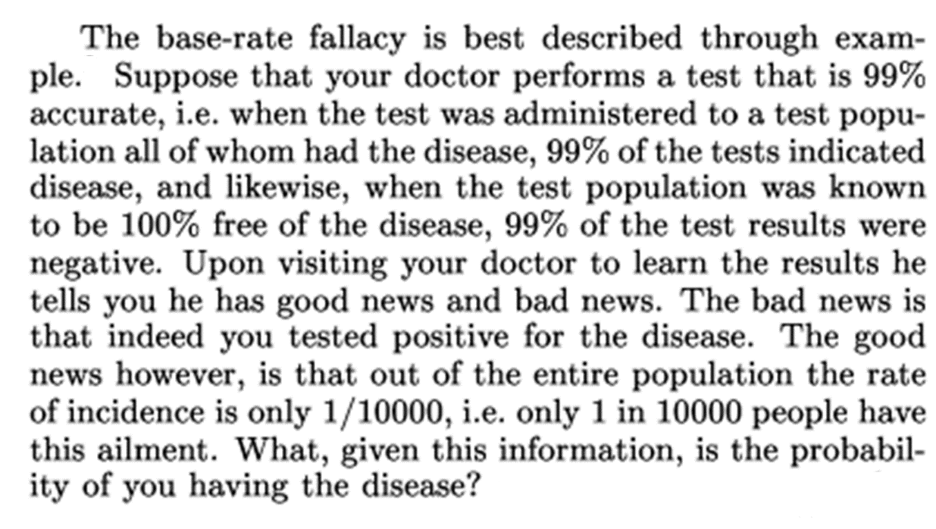
Base Rate Fallacy (Axelsson, 1999)

Slide 46


Base Rate Fallacy
Even though the test is 99% certain, your chance of having the disease is 1/100, because the population of healthy people is much larger than sick people

Slide 47
Base Rate Fallacy in Intrusion Detection
I: intrusive behavior, ¬I: non-intrusive behavior A: alarm ¬A: no alarm
Detection rate (true positive rate): P(A|I)
False alarm rate: P(A|¬I)
Goal is to maximize both
Bayesian detection rate, P(I|A)
P(¬I|¬A)

Slide 48



Detection Rate vs False Alarm Rate
Suppose:
Then:
False alarm rate becomes more dominant if P(I) is very low
20 intrusions
Per million

Slide 49
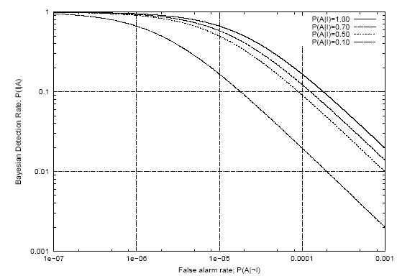
Detection Rate vs False Alarm Rate
Axelsson: We need a very low false alarm rate to achieve a reasonable Bayesian detection rate

Slide 50
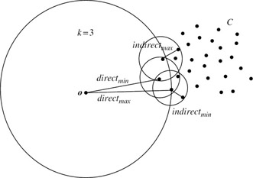
Local Outlier Factor: LOF
An object deep within a consistent cluster, the local outlier factor is close to 1. This property ensures that objects inside clusters, no matter whether the cluster is dense or sparse, will not be mislabeled as outliers.

Slide 51
Local Outlier Factor: LOF

Slide 52

Local Outlier Factor: LOF
LOF captures the relative density of an object.

Slide 53
Prescribed Text Books
 | Author(s), Title, Edition, Publishing House
T1 | Tan P. N., Steinbach M & Kumar V. “Introduction to Data Mining” Pearson Education
T2 | Data Mining: Concepts and Techniques, Third Edition by Jiawei Han, Micheline Kamber and Jian Pei Morgan Kaufmann Publishers
R1 | Predictive Analytics and Data Mining: Concepts and Practice with RapidMiner by Vijay Kotu and Bala Deshpande Morgan Kaufmann Publishers

Slide 54
THANK YOU
Q & A

